Slide 1
Energy Consumption and Emission Modeling of Individual Vehicles Using MOVES-Matrix
Guensler et al.
Poster presentation
Monday 01/09/2017, 3:45 PM- 5:30 PM
Hall E, Convention Center
Daejin Kim, Ph.D. Student
Civil Engineering
Georgia Institute of Technology

Slide 2
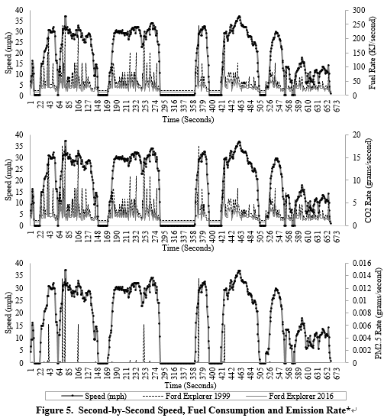
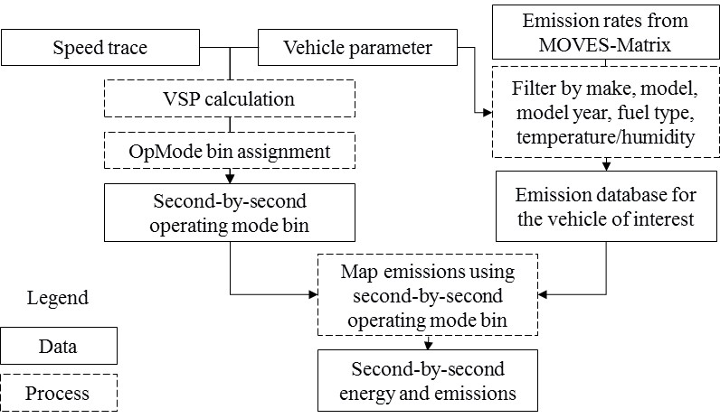
Second-by-second fuel consumption and emission rates results (example)
MOVES-Matrix¹⁾ Calculator (MMC) Algorithm Design
¹⁾ MOVES-Matrix: a high performance vehicle emission modeling system consisting of a multi-dimensional array of vehicle emission rates (pulled directly from the US Environmental Protection Agency’s MOVES emissions model)

